Slide 1
Assessment

Slide 2
Types of assessment
UASPs / Internal unit assessments
Coursework
Final exam

Slide 3
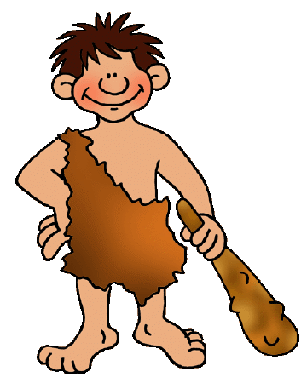
Day | 4pm – 5pm | 7pm – 8pm | 8pm – 9pm | 9pm – 9.30pm
Monday | Hockey Club | English | History | French
Tuesday | English | Football Training | French | Maths
Wednesday | French | Maths | X Box | PE
Thursday | History | Football Training | Maths | English
Friday | PE
Day | 9.30 – 10.30 | 11 - 12 | 12.30 – 1.30
Saturday | Maths | French | History
Sunday | English | PE | French

